Slide 1
线性回归的从零开始
Eng Teong Cheah

Slide 2
Objective
We saw how a deep network can be implemented from scratch, using just NDArray and autograd, without any need for defining layers, fancy optimizers, etc. This only scratches the surface of what is possible.

Slide 3
目录
线性回归的从零开始

Slide 4

线性回归的从零开始

Slide 5
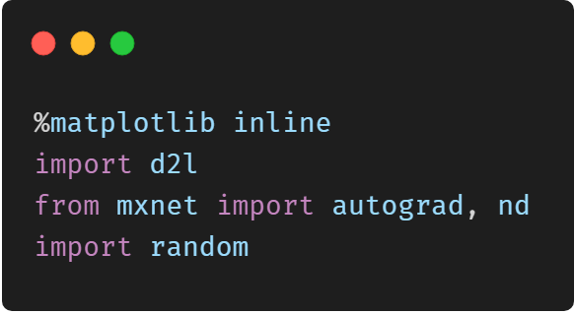
线性回归从零开始

Slide 6
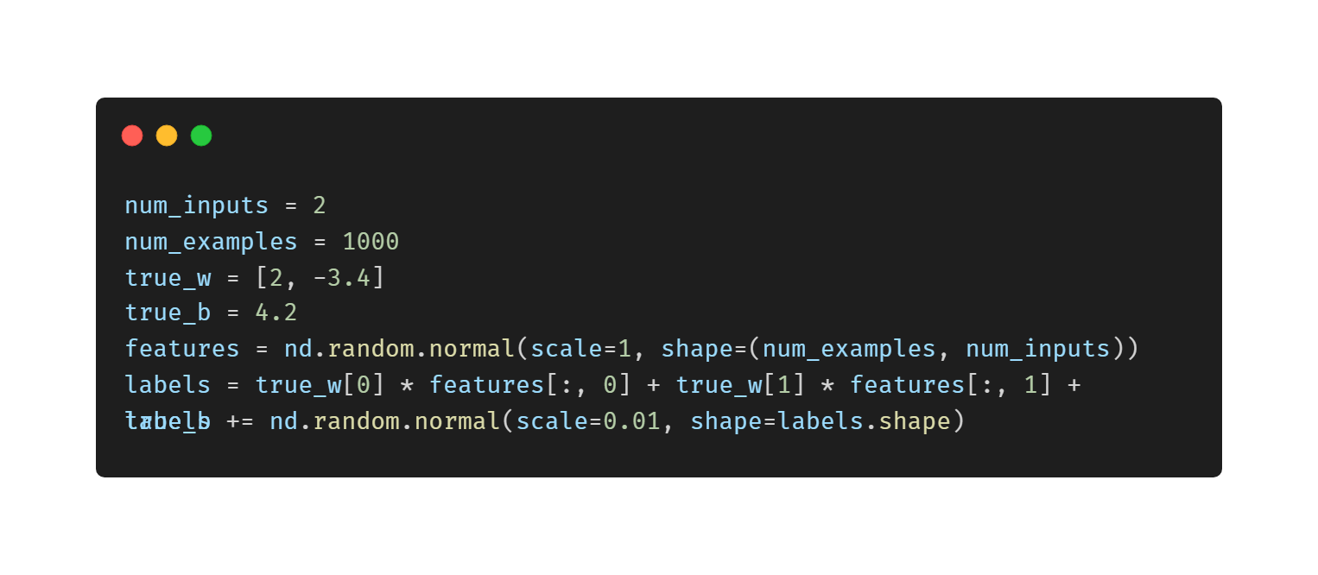
生成数据集

Slide 7
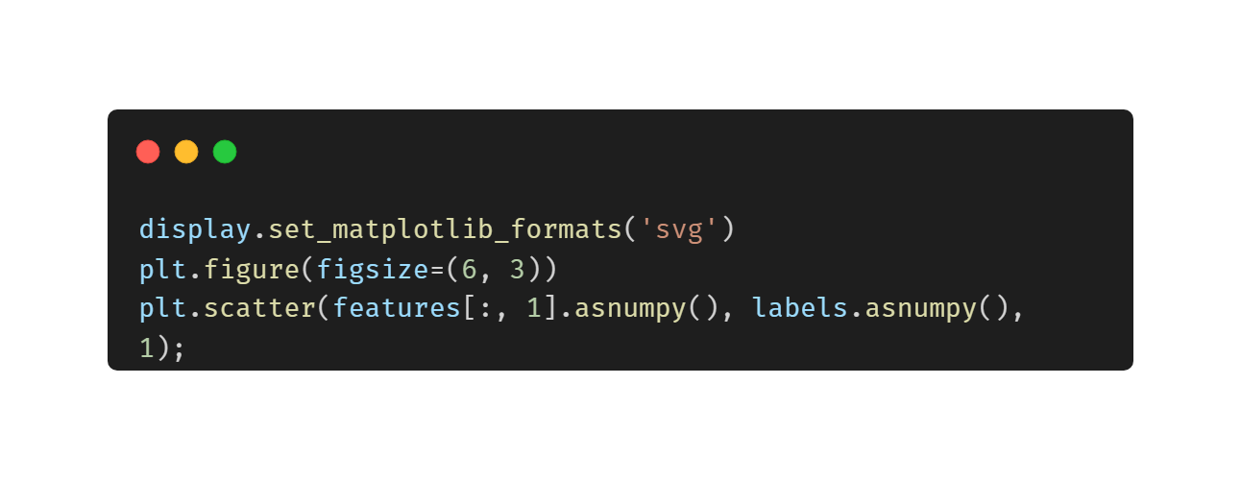
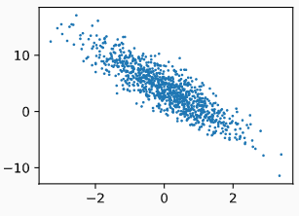
散点图

Slide 8
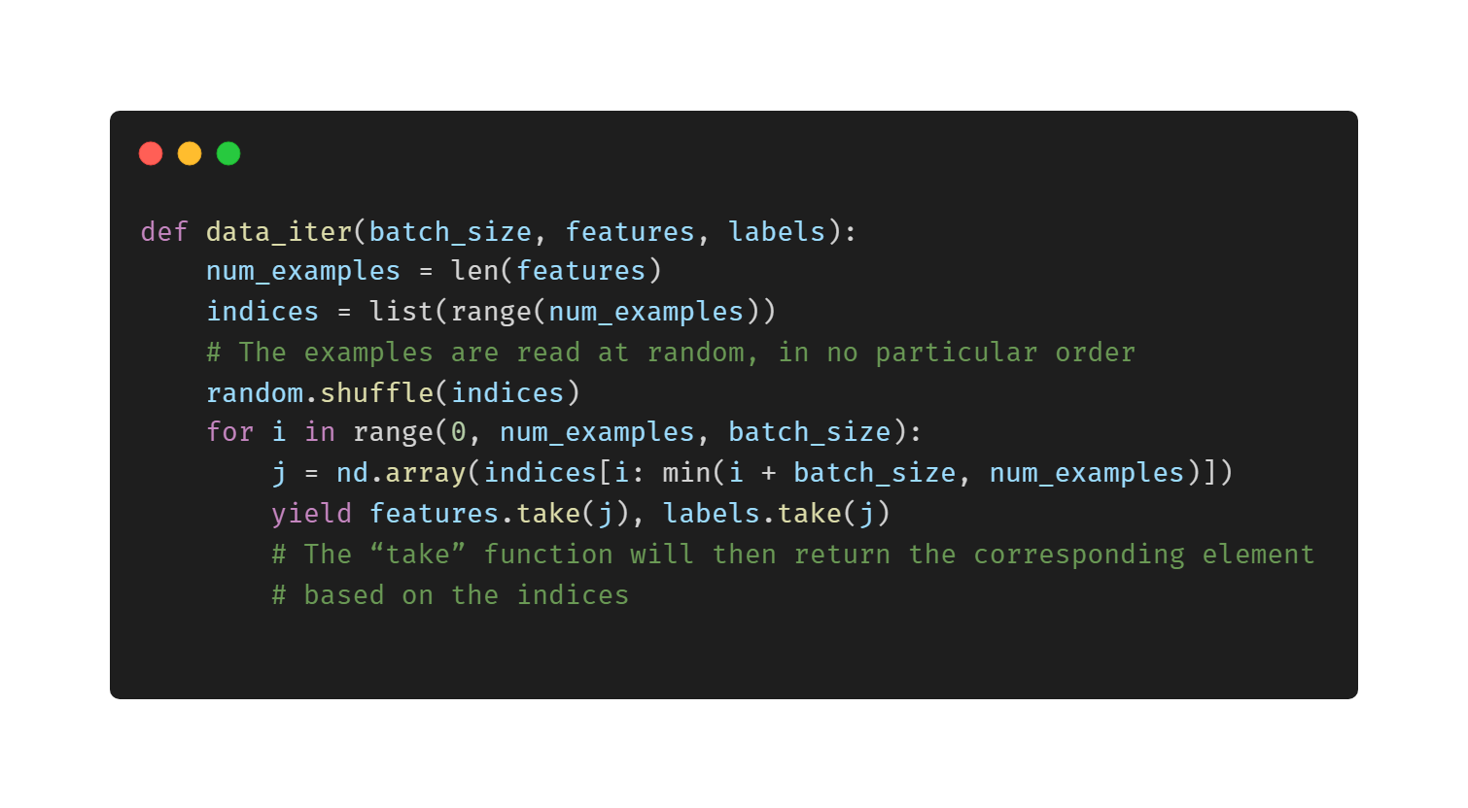
读取数据

Slide 9
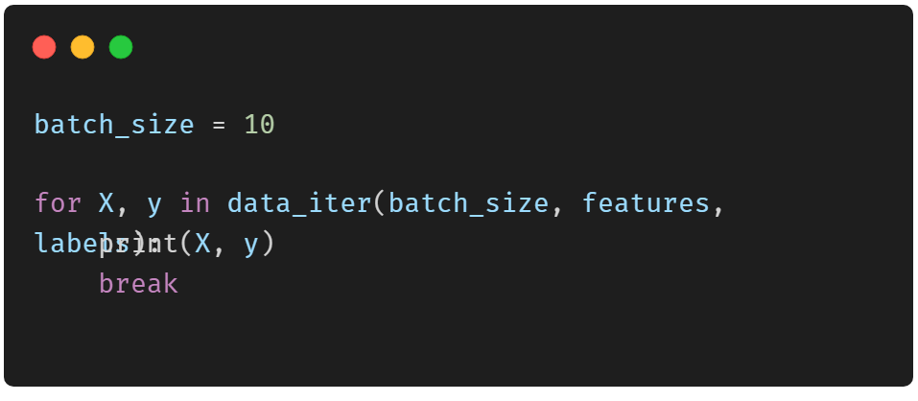
小批量数据样本打印
[[ 1.7130351 2.0944266 ] [-1.95122 -1.0635319 ] [ 0.22546557 0.8499169 ] [-1.6903632 -0.15907401] [ 0.85316896 1.0389048 ] [-0.17798574 1.410267 [-2.152955 -1.3841926 ] [ 0.8605494 -0.22276537] [-0.33177793 -0.99060804] [ 2.584889 -1.1416703 ]] <NDArray 10x2 @cpu(0)> [ 0.5036066 3.9271483 1.7579273 1.353747 2.3738737 – 4.593405 6.6843915 6.8792953 13.258079 ] NDArray 10 @cpu(0)>

Slide 10
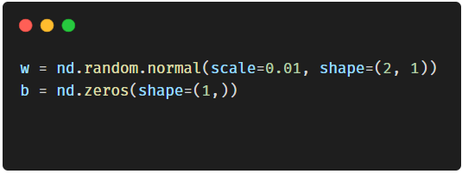
初始化模型参数

Slide 11
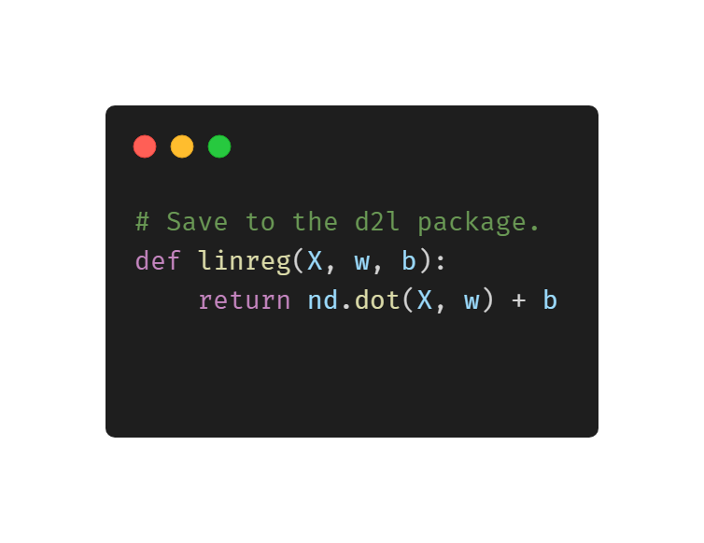
定义模型

Slide 12
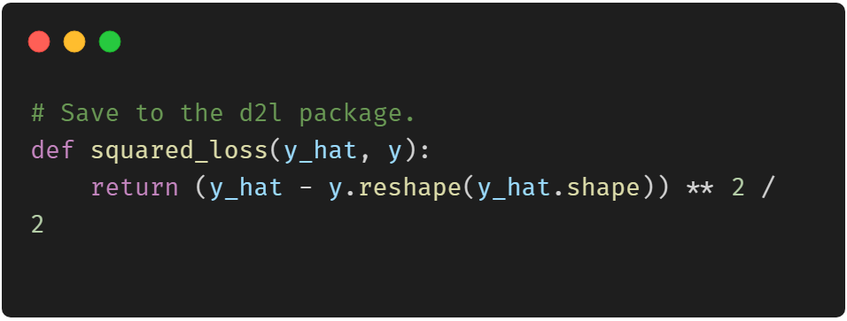
定义损失函数

Slide 13
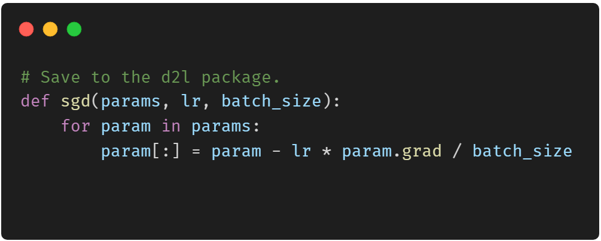
定义优化算法

Slide 14
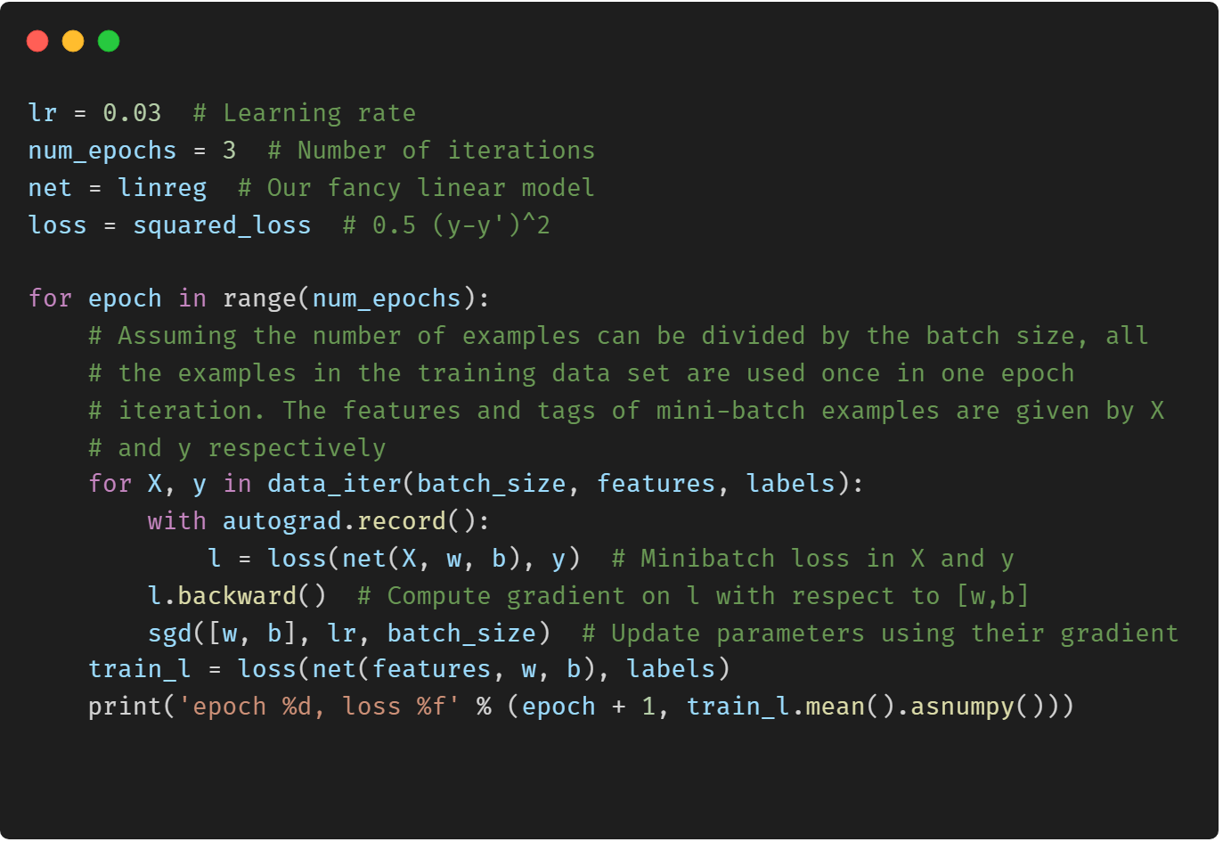
训练模型

Slide 15
谢谢!
Does anyone have any questions?
Twitter: @walkercet
Blog: https://ceteongvanness.wordpress.com

Slide 16
资源
Dive into Deep Learning

